Slide 1
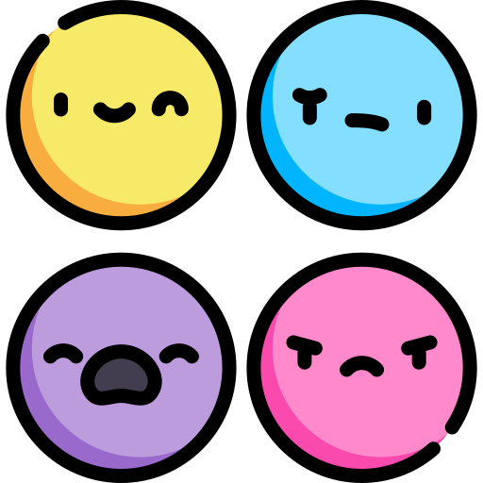

CompSci club
Flowcharts
Let’s flow! (with flowcharts)

Slide 2
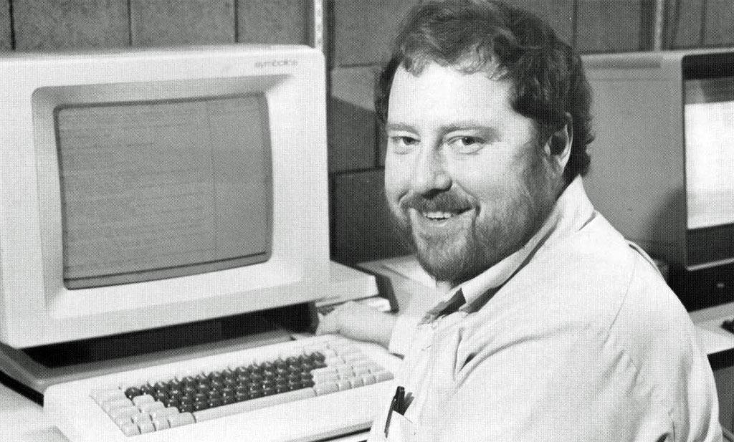
Our person of the day!
Scott Fahlman
Have you ever used :), :(, :P before?
Well, you have Scott Fahlman to thank for that, who invented these amazing digital faces 40 years ago on September 19, 1982
He originally created emoticons to distinguish silly posts from serious posts on a message board, and the first two created were :-) and :-(
Scott is formally retired from Carnegie Mellon University, but he still is active in research, advising and other departmental activities
He actually is a Computer Scientist that isn’t the amazing design major you might expect, but he is primarily focused in Artificial Intelligence
Fahlman was a key designer of the Common Lisp programming language, a language that we have never heard about but looks cool (we think?) ¯\_(ツ)_/¯
Inventor of Emoticons

Slide 3
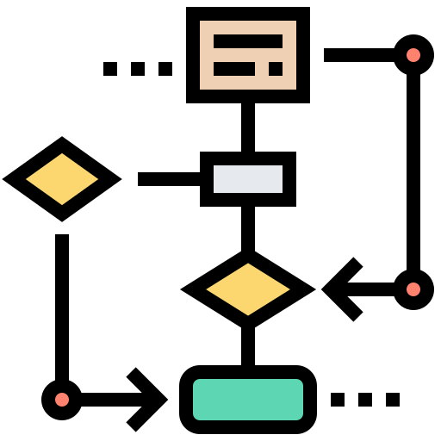
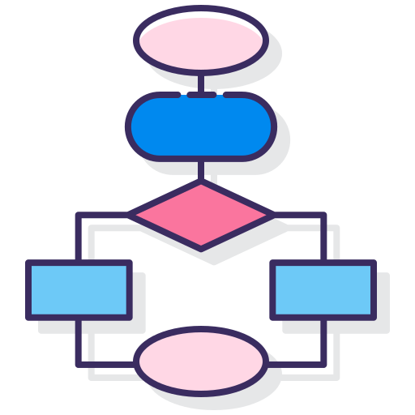
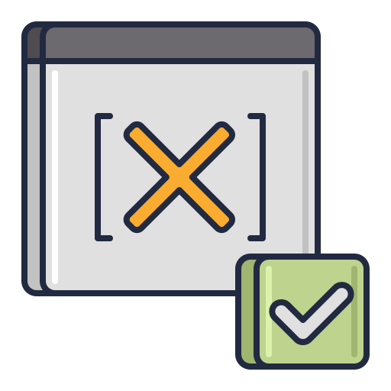
Roadmap for Today
What is a flowchart?
The essential backbone of a programming project
Parts of a Flowchart
A familiar concept, just in a new form!
Practice
Let’s get some hands-on practice with flowcharting!
Notes:
Ask what Github is and what version control is

Slide 4
Cool cool cool
introduction
flowchart

Slide 5
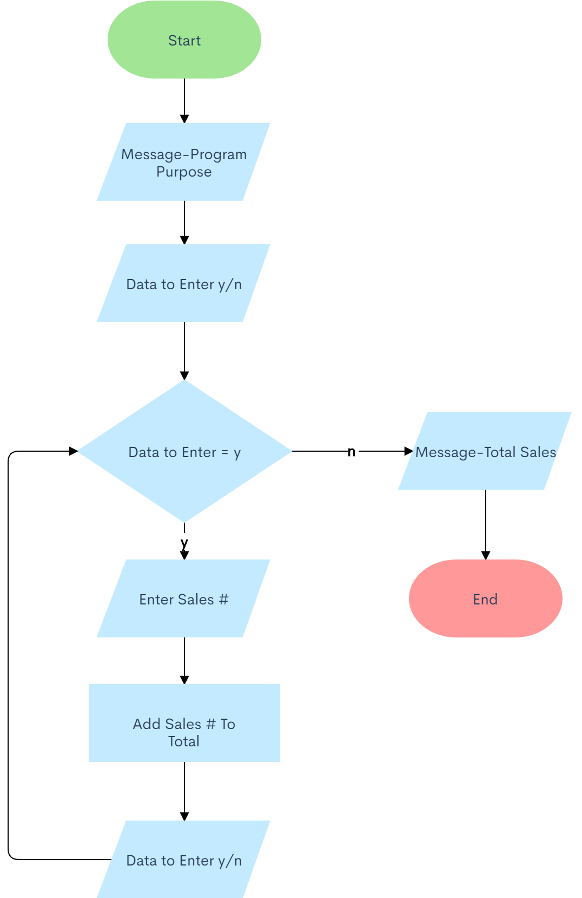
Introduction to flowcharts
A flowchart is a diagram made by the programmer to depict the “flow” of the program. Graphically depicts the logical steps in your program.
Important to know: A flowchart should not just be steps of code, it should not have syntax. A flowchart is something that you first do before even starting a program - to have an idea of what things your program should do, not how the program will do it. Please do not write every single part of your program in the flowchart - flowcharts are high level.

Slide 6
A very easy way to iterate over lists!
PArts of a
flowchart

Slide 7
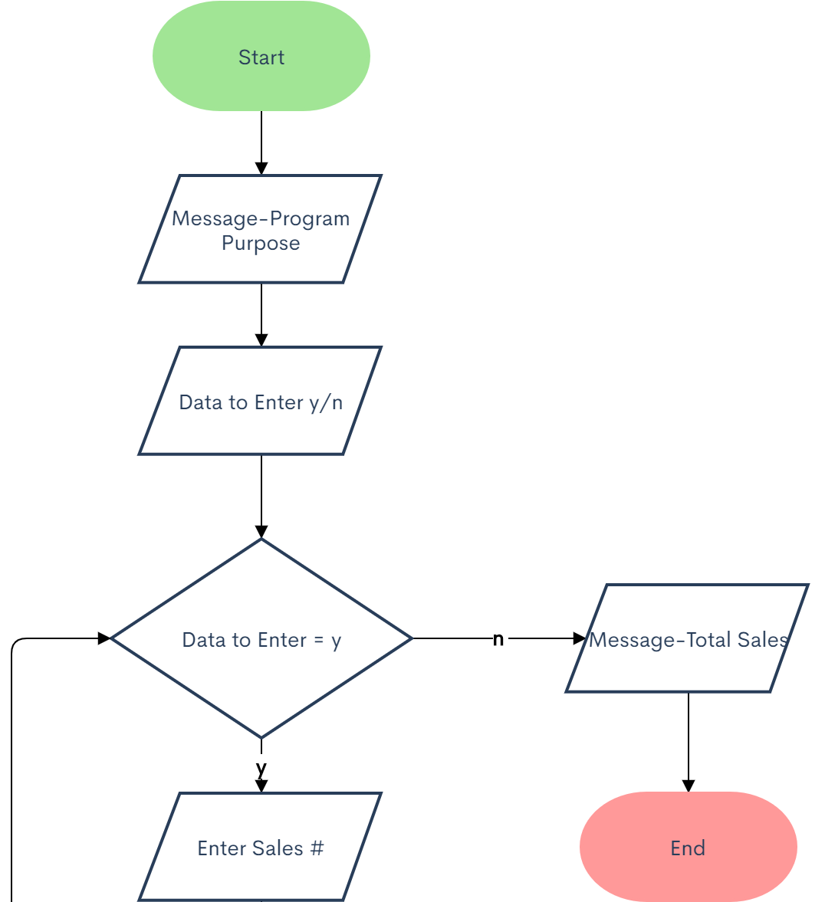
PArts of a flowchart
Terminal
Terminal is used to represent the beginning (Start) or the end (End) of a program
Terminals have to be used - A program can not begin without a Start terminal or end without an End terminal.
There can only be one Start terminal and one End terminal, if there are multiple processes that can end your program, you have to connect all those things to one End terminal.
A terminal looks like a rounded rectangle

Slide 8
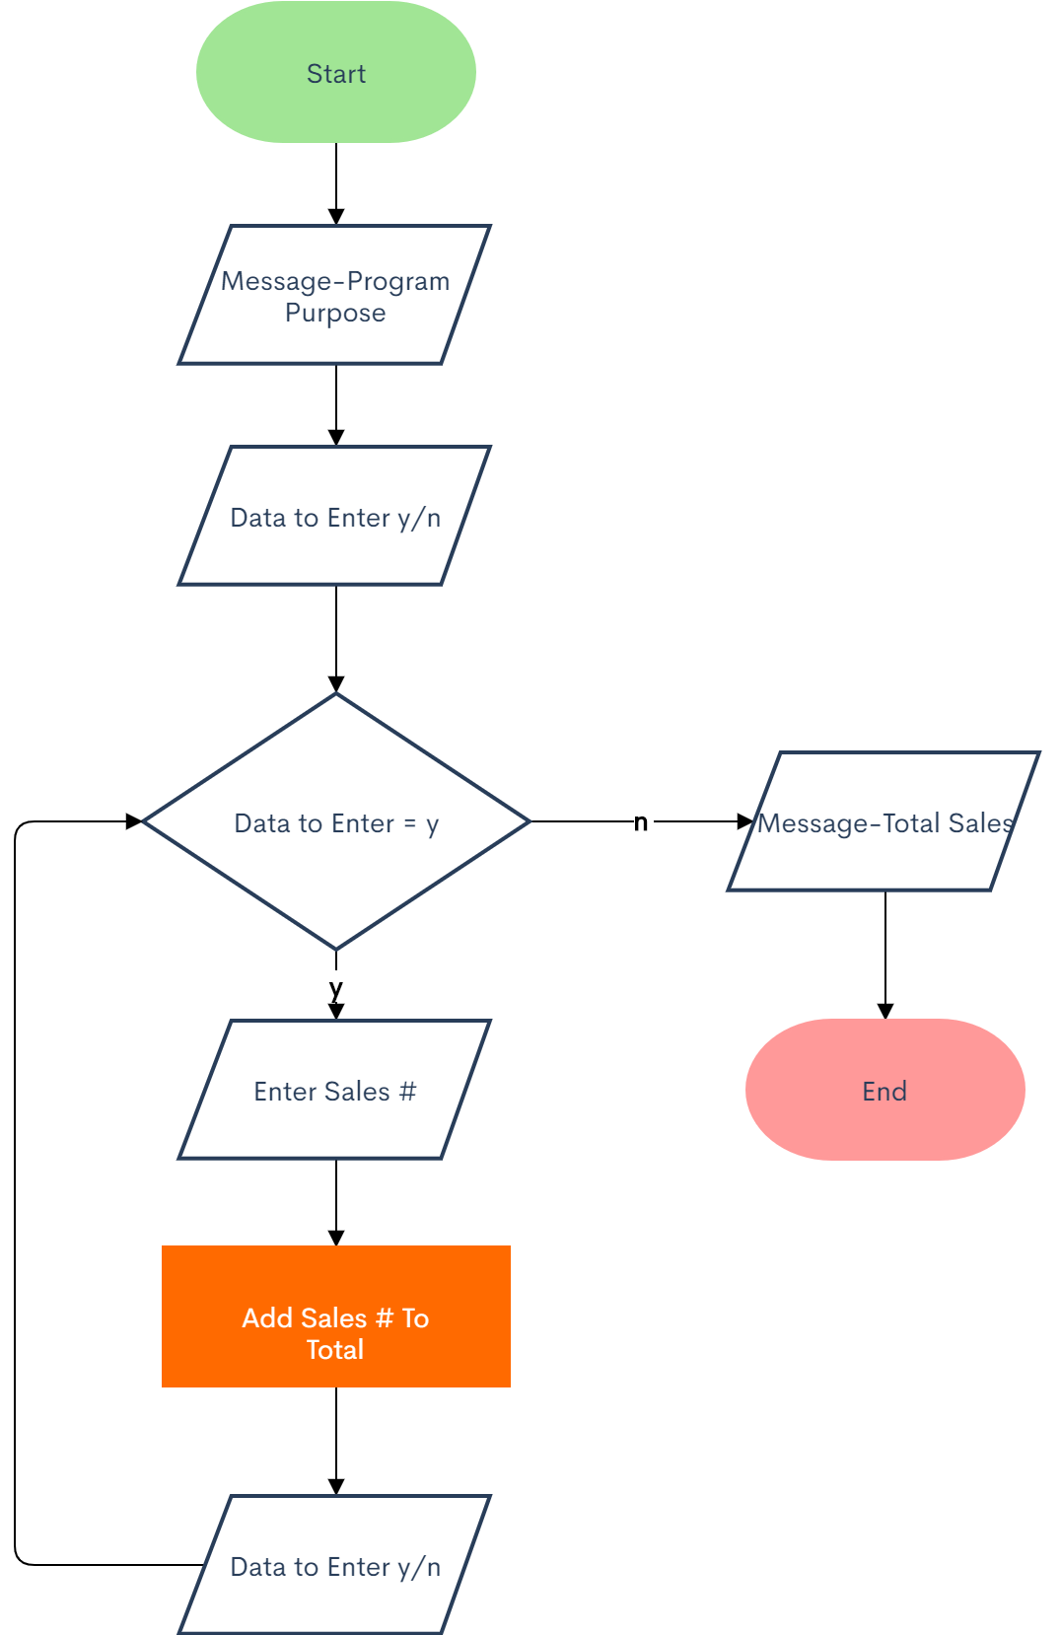
PArts of a flowchart
Processing
Processing is used for arithmetic and data-manipulation operations.
A more simple definition is - if it's not anything else that we have learned about, it is this.
Your flowchart will most likely consist of mostly processing cells. Processing cells are the most common cells in a flowchart and the most simple cells.
Processing cells look like a rectangle

Slide 9
PArts of a flowchart
Input/Output
Used for input and output operations, like reading or getting info from user (user typing something in) and things like displaying data.
The Input/Output process call looks like a parallelogram.

Slide 10
PArts of a flowchart
Decision
Used for any logic or comparison operations. Unlike input/output and processing symbols, which have one entry and one exit, the Decision cell has one entry and two exits, the path chosen will depend on the answer to a yes or no question.
Note: The questions has to be answered by either a “yes” or “no”
The decision cell looks like a diamond.

Slide 11
PArts of a flowchart
Decision
A flowline is used to connect other symbols together to indicate the flow of the logic in the flowchart
Looks like an arrow

Slide 12
Some helpful notes and tips:
Especially if you are a new programmer: Make the flowchart before starting to code
Even if you are not new, you can not do everything in your head, you are past simple coding problems, you are writing harder code that has multiple parts, so making a flowchart will help with that, and take strain off your brain
You should learn how to make a flowchart now, because if you are thinking of going into the professional field of computer science, flowcharts will be used a lot there, as you will be collaborating with other people, and you are supposed to explain your thought process to them and explain how a program works on a high level without going into technical stuff.
We will encourage everyone to make a flowchart, and if you will ask us why your program is not working, unless it is a really specific thing, we will ask if you have made a flowchart, because we know they help a lot, and some people like Fillip, who knew about flowcharts, but refused to use them to plan things out, got punished for doing so.
Flowcharts help a lot, we cannot stress this enough, and that goes to coders of any level.

Slide 13
A lot of flowcharts for individual programmers are done by hand on a piece of paper, you guys have whiteboards, so you can use those.
Professional environments use apps in order to make those flowcharts, or a big whiteboard.
A website that you can use in order to make flowcharts:
Lucidchart.com - Free software, easy drag-and-drop and is free, can also share flowcharts with other people
Zenflowchart.com - A very simple, easy way to be aesthetically beautiful flowcharts

Slide 14
Putting what we learned into good practice!
Finally, we have
Practice with flowcharts

Slide 15
Problem Set One
Now you practice!
Here are so prompts for you to make a flowchart for:
Create a flowchart for making a cup of tea in the morning
Create a flowchart for getting ready for school in the morning
Notes:
https://www.stepneyallsaints.school/content/uploads/2020/07/BTEC-Computing-Task-3-Problem-solving.pdf — page 16
http://cmra.rec.ri.cmu.edu/products/vex_easy_c/programming/logic/Flow_Charts.pdf — page 5

Slide 16
Problem Set Two
Lets try some more program-y flowcharts:
Add two numbers entered by the user.
Find the largest among three different numbers entered by the user.
Write a flowchart for a guessing game where the user has to guess a secret number. After every guess the program tells the user whether their number was too large or too small. If you guess that number, then the program says “Good Job!”

Slide 17
If you have any questions at all, please don’t hesitate to stay back or email one of us!
Thank you!
That is all we have for today!

